Slide 1
Abstractive Text Summarization Using Transformers
By:
Emilio Vasquez

Slide 2
Project Overview:
Datasets - APIs
Transformer Models - T5, BART, and GPT-3.5
Models Evaluation
Models Performance
Testing Best Models Performance on other domains
Integration of Best Model into website

Slide 3
Datasets:
CNN/DailyMail:
https://datasets-server.huggingface.co/rows?dataset=cnn_dailymail&config=1.0.0&split=train&offset=0&length=100
Each dataset contains the article, unique_id, and highlights.
Using article for training and highlights for evaluation.
Comparing Generated Summary of first article:
Harry Potter star Daniel Radcliffe gets £20M fortune as he turns 18 Monday . Young actor says he has no plans to fritter his cash away . Radcliffe's earnings from first five Potter films have been held in trust fund .

Slide 4
Datasets:
Actual Text of Generated Summaries:
LONDON, England (Reuters) -- Harry Potter star Daniel Radcliffe gains access to a reported £20 million ($41.1 million) fortune as he turns 18 on Monday, but he insists the money won\'t cast a spell on him. Daniel Radcliffe as Harry Potter in "Harry Potter and the Order of the Phoenix" To the disappointment of gossip columnists around the world, the young actor says he has no plans to fritter his cash away on fast cars, drink and celebrity parties. "I don\'t plan to be one of those people who, as soon as they turn 18, suddenly buy themselves a massive sports car collection or something similar," he told an Australian interviewer earlier this month. "I don\'t think I\'ll be particularly extravagant. "The things I like buying are things that cost about 10 pounds -- books and CDs and DVDs." At 18, Radcliffe will be able to gamble in a casino, buy a drink in a pub or see the horror film "Hostel: Part II," currently six places below his number one movie on the UK box office chart. Details of how he\'ll mark his landmark birthday are under wraps. His agent and publicist had no comment on his plans. "I\'ll definitely have some sort of party," he said in an interview. "Hopefully none of you will be reading about it." Radcliffe\'s earnings from the first five Potter films have been held in a trust fund which he has not been able to touch. Despite his growing fame and riches, the actor says he is keeping his feet firmly on the ground. "People are always looking to say \'kid star goes off the rails,\'" he told reporters last month. "But I try very hard not to go that way because it would be too easy for them." His latest outing as the boy wizard in "Harry Potter and the Order of the Phoenix" is breaking records on both sides of the Atlantic and he will reprise the role in the last two films. Watch I-Reporter give her review of Potter\'s latest » . There is life beyond Potter, however. The Londoner has filmed a TV movie called "My Boy Jack," about author Rudyard Kipling and his son, due for release later this year. He will also appear in "December Boys," an Australian film about four boys who escape an orphanage. Earlier this year, he made his stage debut playing a tortured teenager in Peter Shaffer\'s "Equus." Meanwhile, he is braced for even closer media scrutiny now that he\'s legally an adult: "I just think I\'m going to be more sort of fair game," he told Reuters. E-mail to a friend . Copyright 2007 Reuters. All rights reserved.This material may not be published, broadcast, rewritten, or redistributed.'

Slide 5
T5
T5 is a Text-to-Text Transfer Transformer model developed by Google.
Core idea is to convert input text into output text for all tasks.
T5 is a versatile and powerful model that is capable of performing various natural language processing (NLP) tasks using a unified text-to-text framework.
Generates concise and informative summaries of longer texts.
T5 Model Generated Summary:
he will be able to gamble in a casino buy a drink in a pub or see the horror film Hostel Part II currently six places below. he will be able to see the horror film Hostel Part II currently six places below. despite his growing fame and riches the actor says he is keeping his feet firmly on the ground. his latest outing as the boy wizard in Harry Potter and the Order of the Phoenix is breaking records on both sides of the Atlantic. he has filmed a tv movie called My Boy Jack about author Rudyard Kipling and his son due for release later this year He will also appear in December Boys an Australian film about four boys who escape an orphanage. he made his stage debut playing a tortured teenager in Peter Shaffer s Equus earlier this year.
Fine-Tuned T5 Generated Summary:
he will be able to gamble in a casino buy a drink in a pub or see the horror film Hostel Part II currently six places below his number one movie on the UK box office chart. despite his growing fame and riches the young actor says he is keeping his feet firmly on the ground.

Slide 6
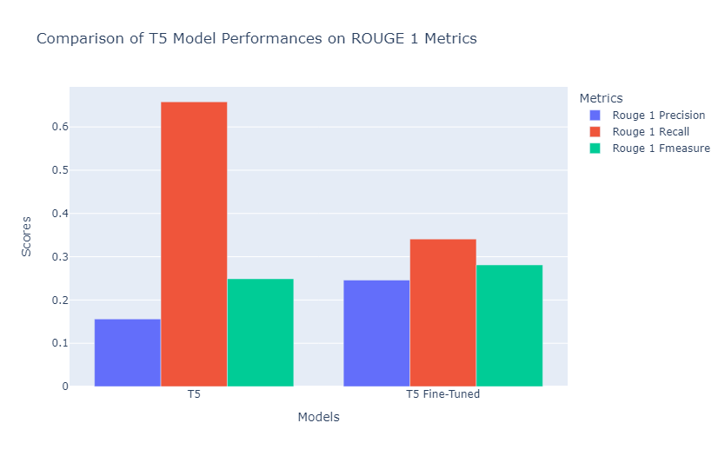
T5
Precision is the accuracy of, recall is the finding all the positive instances and F1 is the balance between precision and recall
T5 ROUGE-1
Precision | Recall | F1
0.1563 | 0.6576 | 0.2494
ROUGE-2
0.0671 | 0.2760 | 0.1069
ROUGE-L
0.1031 | 0.4263 | 0.1641
Fine-Tuned T5 ROUGE-1
Precision | Recall | F1
0.2462 | 0.3412 | 0.2813
ROUGE-2
0.0807 | 0.1114 | 0.0924
ROUGE-L
0.1614 | 0.2300 | 0.1869
Average T5 Scores: cosine similarity score 0.3214415377008123 , average of BLEU score 0.0547375357558972 , average of METEOR 0.35688821790239855
Average Fine-Tuned T5 Scores: cosine similarity score 0.22070024563927326 , average of BLEU score 0.03317890877765527 , average of METEOR 0.24010528472913828

Slide 7
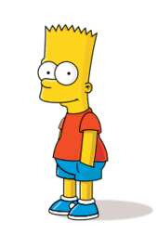
BART
Bidirectional and Auto-Regression Transformers (BART)
denoising autoencoder built with a sequence-to-sequence model
Combination of Transformers
Bidirectional
Auto-Regressive
BART Model Generated Summary:
Harry Potter star Daniel Radcliffe gains access to a reported 20 million 41 1 million fortune as he turns 18 on Monday. Radcliffe says he has no plans to fritter his cash away on fast cars drink and celebrity parties. Radcliffe s earnings from the first five Potter films have been held in a trust fund which he has not been able to touch. Details of how he ll mark his landmark birthday are under wraps. The Londoner has filmed a TV movie called My Boy Jack about author Rudyard Kipling and his son. He will also appear in December Boys an Australian film about four boys who escape an orphanage. Earlier this year he made his stage debut playing a tortured teenager in Peter Shaffer s Equus
Fine-Tuned BART Generated Summary:
Harry Potter star Daniel Radcliffe gains access to a reported 20 million fortune as he turns 18 on Monday. The actor says he has no plans to fritter his cash away on fast cars drink and celebrity parties. Radcliffe s earnings from the first five Potter films have been held in a trust fund which he has not been able to touch.

Slide 8
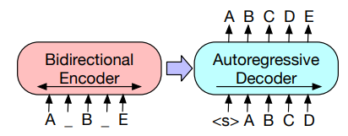
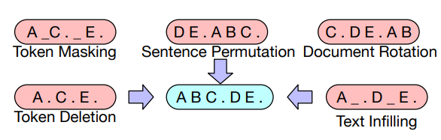
BART Model
Lewis et al (2019)

Slide 9
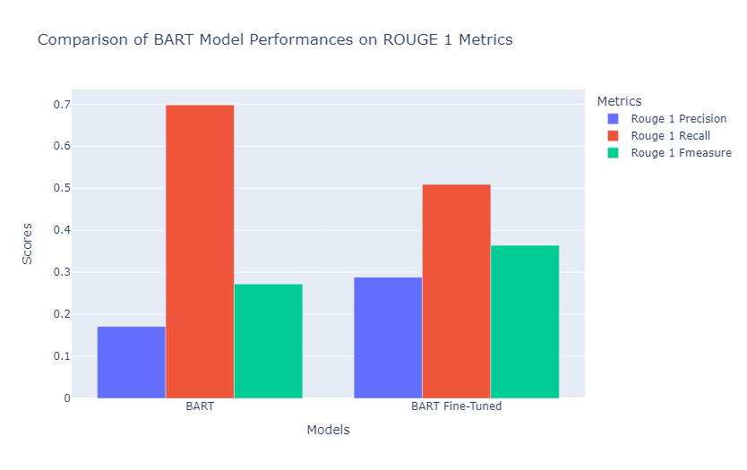
BART
Precision is the accuracy of, recall is the finding all the positive instances and F1 is the balance between precision and recall
BART ROUGE-1
Precision | Recall | F1
0.1713 | 0.6978 | 0.2721
ROUGE-2
0.0820 | 0.3252 | 0.1296
ROUGE-L
0.1125 | 0.4429 | 0.1774
Fine-Tuned BART ROUGE-1
Precision | Recall | F1
0.2876 | 0.5092 | 0.3647
ROUGE-2
0.1254 | 0.2247 | 0.1601
ROUGE-L
0.2036 | 0.3663 | 0.2599
Average BART Scores: cosine similarity score 0.29781103042950635 , average of BLEU score 0.07363850827561946 , average of METEOR 0.38112193669566696
Average Fine-Tuned BART Scores: cosine similarity score 0.30701809827094484 , average of BLEU score 0.08018187060507384 , average of METEOR 0.3865391612394588

Slide 10
GPT-3.5
Generative Pre-trained Transformer (GPT)
GPT-3.5 Third iteration of GPT developed by OpenAI
175 Billion parameters
GPT Model Generated Summary:
Harry Potter star Daniel Radcliffe, who turned 18 on Monday, gains access to a reported £20 million ($41.1 million) fortune but insists that he won't be extravagant with his newfound wealth. Radcliffe says he has no plans to spend his money on fast cars, drink, or celebrity parties. He prefers buying things that cost around £10 like books, CDs, and DVDs. Radcliffe's earnings from the first five Potter films have been held in a trust fund, which he has not been able to touch. Despite his growing fame and riches, the actor says he is keeping his feet firmly on the ground and trying to avoid going off the rails like other child stars. Radcliffe's latest film, Harry Potter and the Order of the Phoenix, is breaking records in both the UK and the US. He also has other projects lined up, including a TV movie and an Australian film. With his newfound adult status, Radcliffe expects even closer media scrutiny.
Prompt-Engineered GPT Generated Summary:
Daniel Radcliffe, the star of the Harry Potter films, has turned 18 and gained access to his £20 million fortune. Despite his new wealth, Radcliffe insists that he won't become extravagant and plans to continue his modest spending habits on books and DVDs. He also stated that he will have a party to celebrate his birthday, but details of the event are under wraps. Radcliffe’s earnings from the Harry Potter films have been held in a trust fund that he has not been able to touch.

Slide 11
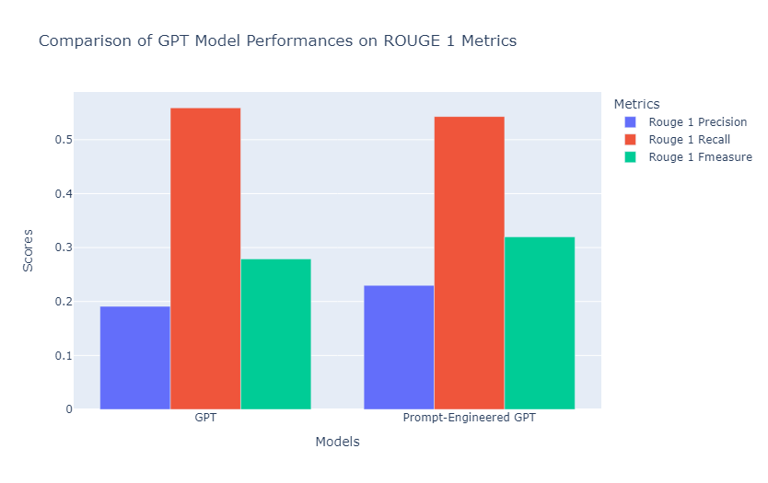
GPT-3.5 Model
Autoregression Language Model using transformer architecture
GPT ROUGE-1
Precision | Recall | F1
0.1908 | 0.5587 | 0.2796
ROUGE-2
0.0642 | 0.1910 | 0.0946
ROUGE-L
0.1084 | 0.3226 | 0.1594
Prompt-Engineered GPT ROUGE-1
Precision | Recall | F1
0.2298 | 0.5430 | 0.3202
ROUGE-2
0.0828 | 0.2024 | 0.1167
ROUGE-L
0.1404 | 0.3349 | 0.1963
Average GPT Scores: cosine similarity score 0.2827471481702798 , average of BLEU score 0.024081880944165256 , average of METEOR 0.3293974549754028
Average Prompt-Engineered GPT Scores: cosine similarity score 0.28494080538435174 , average of BLEU score 0.05029308932849104 , average of METEOR 0.35330689890202965

Slide 12
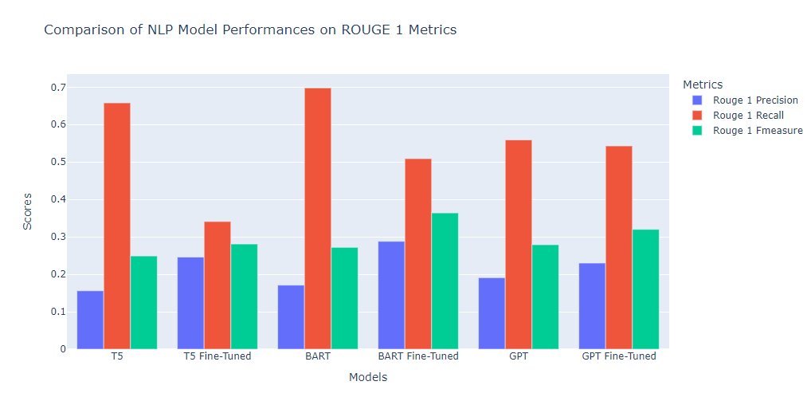
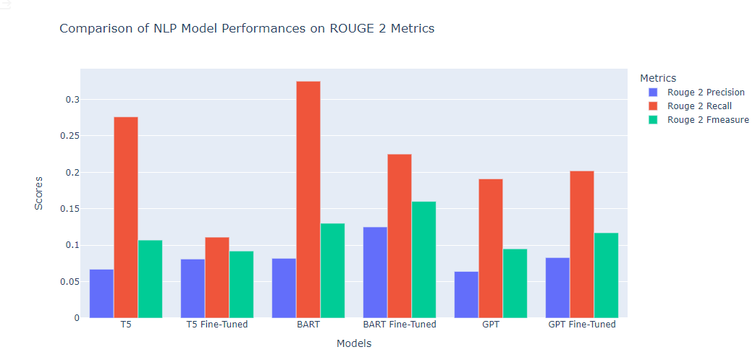
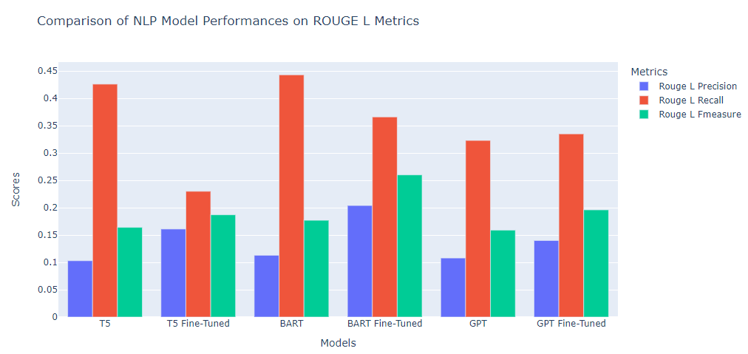
Models Evaluations

Slide 13
Chapter Summarization Comparison to CliffNotes:
Cliff Notes:
The porch sitters are spread out on the front porch of Pheoby and Sam Watson's home, happy to be free of the responsibilities of their long day's labor. They are astonished to see a bedraggled and weary-looking Janie Starks trudging into town, then turning her face in their direction. The women see her as a disaster, but the men see her as still possessing physical attraction. Janie speaks, acknowledges them, and goes on, and their indignation is great. How could she have the nerve not to stop and explain why she went off a year and a half ago in a blue satin dress and now she returns in dirty overalls?
Surely her husband — they assume she married the man, the guitar-playing, roving Tea Cake — took her money and probably went off with a younger woman. After all, Tea Cake was nearly ten years younger than Janie. They believe that Janie should have stopped and talked to them. The inherent jealousy of the women is quite apparent.
Janie's friend Pheoby defends her to the porch sitters. Pheoby believes that Janie does not have to share any of her personal business with them. Assuming that Janie is hungry, Pheoby volunteers to take Janie a pot of mulatto rice, and soon she finds her way through the darkness to Janie's back steps. Pheoby's motive is not completely unselfish. She is quietly certain that Janie will talk to her and explain what happened during the past year and a half. Janie welcomes her friend and the gift of food. She informs Pheoby that Tea Cake did not run off with the money that Joe left her. She reveals that the money is safe in the bank, but Tea Cake is dead. After Janie has rested for a while, cleaned and soothed her tired feet, and enjoyed the rice, she tells Pheoby about her months with Tea Cake.
Prompt-Engineered GPT-3.5:
In this chapter, the author introduces the concept of ships at a distance, symbolizing people's dreams and desires. The chapter then shifts to focus on a woman who has returned home after burying the dead, specifically victims of a tragic event. As she walks through her town, the people on their porches begin to gossip and speculate about her past, criticizing her appearance and actions. The woman, named Janie, approaches her friend Pheoby's porch, where Pheoby defends Janie against the gossip and judgments of others.
Inside the porch, Janie enjoys a meal Pheoby brought her and they talk about the rumors and whispers surrounding Janie's life. Pheoby expresses her curiosity, but Janie dismisses the idea of explaining herself, stating that people don't understand her experiences. Janie reveals that her husband, Tea Cake, has left her, and that is why she has returned home. She explains that she no longer has anything to keep her in her previous location.
Janie emphasizes that there is more to her story than what people assume, but she doesn't feel the need to share it unless someone truly understands her perspective. Pheoby agrees to listen and understand, and they continue their conversation.
The chapter ends with Janie stating that she has depended on Pheoby as a friend for a long time, and she trusts her to have an open mind. Time passes as they talk, and the darkness outside becomes old and weathered, while Janie's words carry wisdom and depth.

Slide 14
Chapter of Book Summarization:
Prompt-Engineered GPT ROUGE-1
Precision | Recall | F1
0.5617 | 0.4392 | 0.4930
ROUGE-2
0.084 | 0.0656 | 0.0736
ROUGE-L
0.2151 | 0.1682 | 0.1888
Cosine Similarity Score: 0.7432
BLEU Score: 0.0210

Slide 15
Integration to Website
Showing the application of Fine-Tuned BART Article Summarizer for Finance Articles on a localhost.

Slide 16
Thank you
C. Raffel et al., "Exploring the Limits of Transfer Learning with a Unified Text-to-Text Transformer," in _2019 Conference on Neural Information Processing Systems (NeurIPS)_, Vancouver, Canada, Dec. 8-14, 2019, pp. 13654–13666. https://arxiv.org/abs/1910.10683
M. Lewis, Y. Liu, N. Goyal, M. Ghazvininejad, A. Mohamed, O. Levy, V. Stoyanov, and L. Zettlemoyer, "BART: Denoising Sequence-to-Sequence Pre-training for Natural Language Generation, Translation, and Comprehension," arXiv preprint arXiv:1910.13461, 2019. [Online]. Available: https://arxiv.org/abs/1910.13461
G. Yenduri et al., “Generative Pre-trained Transformer: A Comprehensive Review on Enabling Technologies, Potential Applications, Emerging Challenges, and Future Directions,” arXiv.org, May 21, 2023. https://arxiv.org/abs/2305.10435
OpenAi, “Language Models are Few-Shot Learners,” arXiv.org, Jun 21, 2022. https://arxiv.org/pdf/2005.14165.pdf
Text Summarization using Transformer Model | IEEE Conference Publication | IEEE Xplore,” ieeexplore.ieee.org. https://ieeexplore.ieee.org/document/10062698
Vaswani, A., Shazeer, N.M., Parmar, N., Uszkoreit, J., Jones, L., Gomez, A.N., Kaiser, L., & Polosukhin, I. (2017). Attention is All you Need. https://arxiv.org/abs/1706.03762

